Slide 1



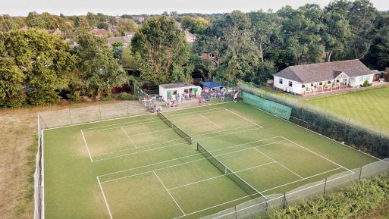
Flackwell Heath Tennis Club
The Straight Bit, Flackwell Heath, HP10 9LS
2023 Junior Tennis Camps, open to all Juniors!
Dates:
Monday 23 Oct
Tuesday 24 Oct
Wednesday 25 Oct
Thursday 26 Oct
Friday 27 Oct
Morning: 10.00 a.m. – 12.45 p.m.
Full Day: 10:00 a.m. – 4:00 p.m.
Morning | £22
1 Day | £37
2 Days | £68
3 Days | £95
4 Days | £120
5 Days | £140
Camps Include
Shot of the day, fun competitions, coaching and mini matches. Tuck Shop.
For Full Details, Call Justin: 07788 591778, E-mail: justincooktennis@live.co.uk or www.jctennis.co.uk
Please complete and send this booking form with payment to Justin Cook bank transfer Sort code: 20-40-71 account number: 30289302 ref players name: Justin Cook, 10 Consul Close, Woodley, Reading, RG5 4ET
----------------------------------------------------------------------------------------------
NAME(S):…………………………………................AGE(S)…………....................
ADDRESS……………………………………………………………..........................
EMERGENCY CONTACT…………………………….............................................
ANY MEDICAL CONDITIONS OR ALLERGIES………………………………......
Date | Morning | Full Day
Monday 23 October
Tuesday 24 October
Wednesday 25 October
Thursday 26 October
Friday 27 October

